Slide 1
Combating Deadlock in RDMA Data Center Networks

Slide 2
Advantages of RDMA Data Center Networks
Ultra-low latency
High throughput
Very low CPU overhead

Slide 3
RDMA is Not Robust by Itself
PFC is key for providing a lossless L2 network as PFC pause frames can always prevent packet loss in time under normal circumstance.
PFC is not for free because it can create deadlock
Routing loop can cause PFC deadlock.
Cyclic routing dependency can cause PFC deadlock.
Device bugs can cause PFC deadlock.

Slide 4
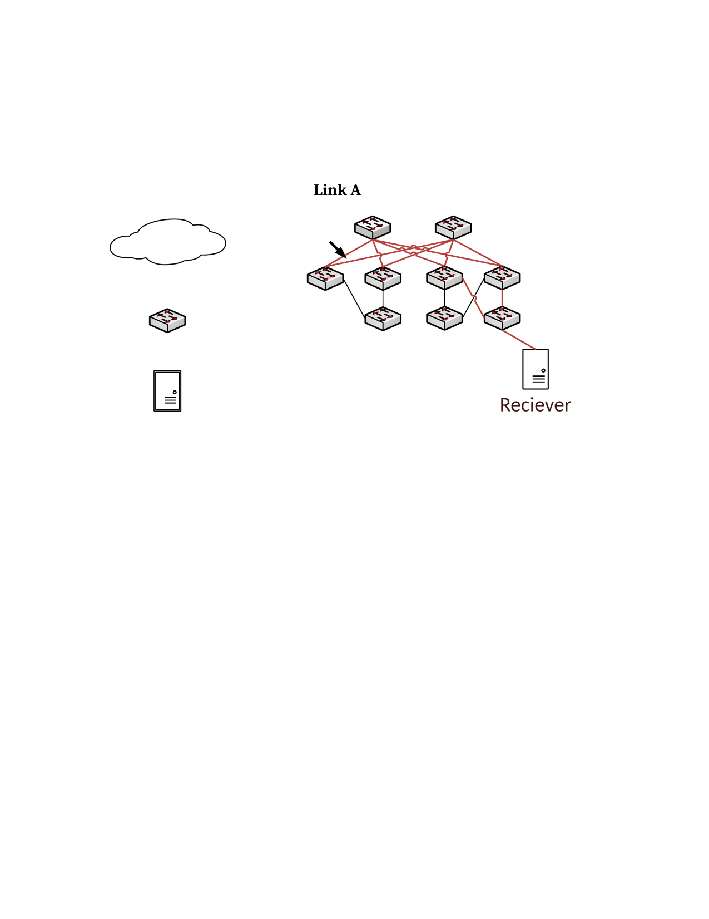

Loop-Induced Deadlock Case in Clos
Core 1
Core 2
10.0.0.0/16 -> Aggr 1,2
10.1.0.0/16 -> Aggr 3,4
10.1.0.0/24 -> ToR 3
10.1.1.0/24 -> ToR 4
Default -> Core 1,2
Aggr 1
Aggr 2
Aggr 3
Aggr 4
ToR 1
ToR 2
ToR 3
ToR 4
H1: 10.0.0.1
H2: 10.1.1.1

Slide 5
Cyclic Routing Induced Deadlock Case in Clos
Core 1
Core 2
Aggr 1
Aggr 2
Aggr 3
Aggr 4
Flow 1
ToR 1
Flow 3
ToR 2
ToR 3
Flow 2
ToR 4
H1: 10.0.0.1
H2: 10.0.1.1
H3: 10.1.0.1
H4: 10.1.1.1

Slide 6
Cyclic Routing Induced Deadlock Case in Clos
Flow 3
Aggr2
Core1
Flow 1
tx
rx
rx
tx
tx-1
rx
Core2
Aggr3
Flow 2
tx-2
rx
tx

Slide 7
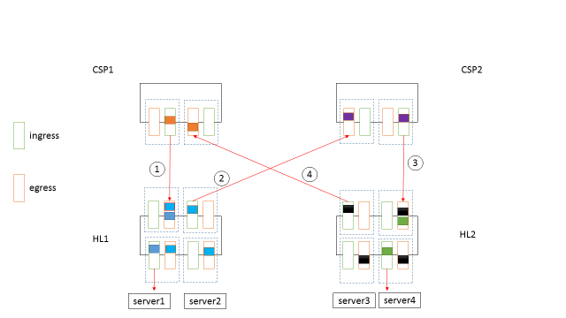
Device Bug Induced Deadlock Case
A deadlock caused by packet flooding bug of Arista switch.

Slide 8
Analysis of Loop-Induced Deadlock

Slide 9
Loop-Induced Deadlock - Routing loop $≠$ Deadlock
Inject Lossless traffic into a 2-hop routing loop:
L1
L2
TTL =16, Link capacity = 40Gbps:
172.16.4.0/31 -> T2
Injection rate | Deadlock
4Gbps | No
5Gbps | No
6Gbps | Yes
172.16.4.5/32 -> L2
T1
T2
H1: 172.16.3.6
H2: 172.16.4.5
Routing loop is just a necessary condition because TTL expiration of packets will prevent packets from building up in the loop.

Slide 10
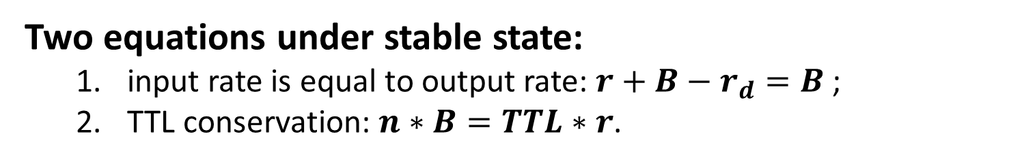
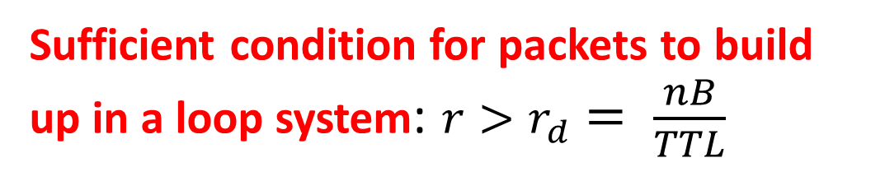
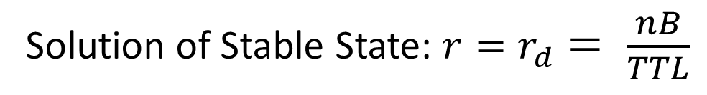
Loop-Induced Deadlock – Impact of TTL Expiration
r | Inject rate of new packets.
B | Link bandwidth.
r_{d} | Packets drain rate caused by TTL expiration.
TTL | TTL value.
n | Hop number of the routing loop.
r
B - r_{d}
qn
Two equations under stable state:
input rate is equal to output rate: $r+B−r_{d}=B$;
TTL conservation: $n∗B=TTL∗r$.
q1
…
B
TTL drain rate
TTL generating rate
Solution of Stable State: $r=r_{d}= \frac{nB}{TTL}$
q2
Basic Model
Sufficient condition for packets to build up in a loop system: $r>r_{d}= \frac{nB}{TTL}$

Slide 11
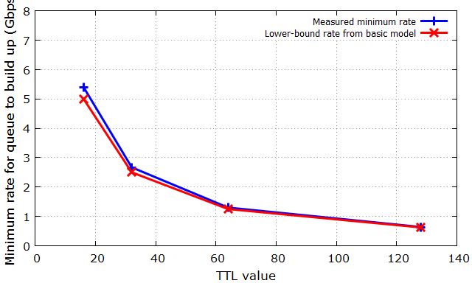
Verification of Basic Model – Exp A
We inject lossy UDP traffic into a 2-hop loop, and measure the minimum input rate at which queue will build up:
Observation: basic model provides a good lower-bound rate above which queue will build up.

Slide 12
Loop-Induced Deadlock - Consider PFC
r
B - r_{d}
Question: what is the sufficient condition for packets to build up when PFC is considered?
qn
t_{PFC}
q1
…
B
q2
Consider PFC

Slide 13
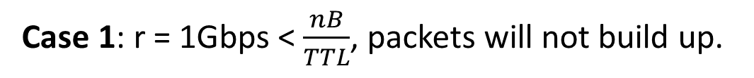
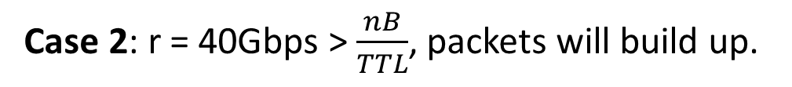
Loop-Induced Deadlock – Queueing Delay
Round | Time unit | Queueing delay | Remaining TTL
#1 | 0 | 0 | 15
#2 | 2 | 0 | 13
#3 | 4 | 0 | 11
#4 | 6 | 0 | 9
#5 | 8 | 0 | 7
#6 | 10 | 0 | 5
#7 | 12 | 0 | 3
#8 | 14 | 0 | 1
Round | Time unit | Queueing delay | Remaining TTL
#1 | 0 | 0 | 15
#2 | 2 | 1 | 13
#3 | 5 | 4 | 11
#4 | 11 | 10 | 9
#5 | 23 | 22 | 7
#6 | 47 | 46 | 5
#7 | 95 | 94 | 3
#8 | 191 | 190 | 1
r = 1Gbps
r = 40Gbps
TTL=16
TTL=16
B=40Gbps
B=40Gbps
Expiration time of the 1st pkt
Expiration time of the 1st pkt
Case 1: r = 1Gbps < $\frac{nB}{TTL}$, packets will not build up.
Case 2: r = 40Gbps > $\frac{nB}{TTL}$, packets will build up.
Observation: Once packets are queued in the loop, r_{d} will be significantly reduced by queueing delay in the loop.

Slide 14
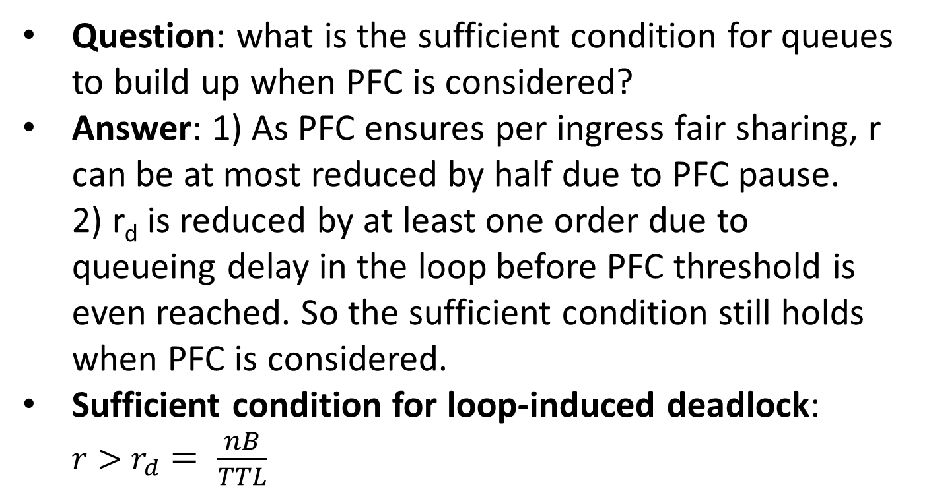
Loop-Induced Deadlock - Consider PFC
r
B - r_{d}
Question: what is the sufficient condition for queues to build up when PFC is considered?
Answer: 1) As PFC ensures per ingress fair sharing, r can be at most reduced by half due to PFC pause. 2) r_{d} is reduced by at least one order due to queueing delay in the loop before PFC threshold is even reached. So the sufficient condition still holds when PFC is considered.
Sufficient condition for loop-induced deadlock: $r>r_{d}= \frac{nB}{TTL}$
qn
t_{PFC}
q1
…
B
q2
Consider PFC

Slide 15

Verification of Basic Model – Exp B
We inject lossless UDP traffic into a 2-hop loop, and measure the minimum input rate at which PFC deadlock will occur:
Observation: our basic model does not consider the impact of PFC pause, but it still provides a good lower-bound input rate above which PFC deadlock will occur

Slide 16
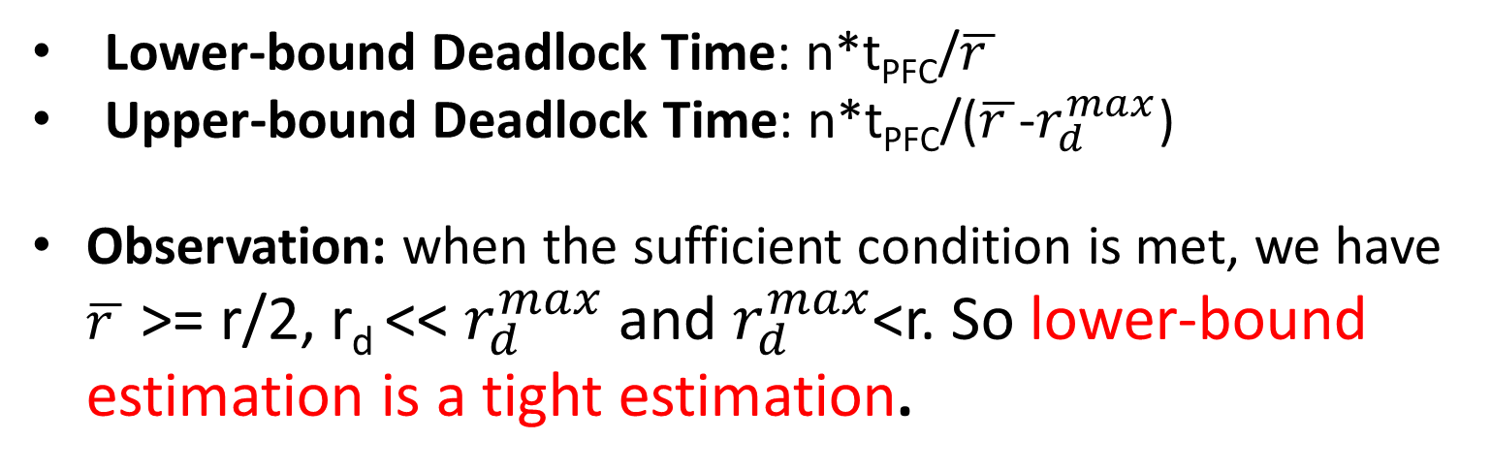
Loop-Induced Deadlock – Deadlock Time
Lower-bound Deadlock Time: n*t_{PFC}/$\overline{r }$
Upper-bound Deadlock Time: n*t_{PFC}/($\overline{r }$-$r_{d}^{max}$)
Observation: when the sufficient condition is met, we have $\overline{r }$ >= r/2, r_{d} << $r_{d}^{max}$ and $r_{d}^{max}$<r. So lower-bound estimation is a tight estimation.

Slide 17
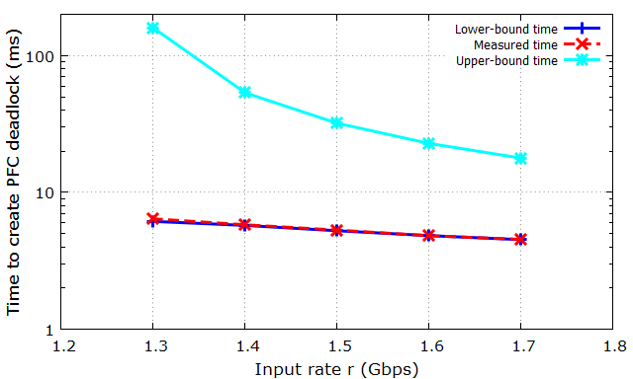
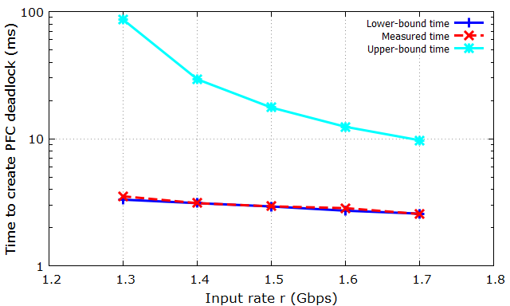
Verification of Estimation of Deadlock Time– Exp C
We inject lossless UDP traffic into a 2-hop loop, and measure the deadlock time:
(a) Setting: TTL = 64, α = 1/32 (no PFC deadlock when r < 1.3Gbps).
(b) Setting: TTL = 64, α = 1/64 (no PFC deadlock when r < 1.3Gbps).
Observation: Lower-bound estimation is a tight bound.

Slide 18
Analysis of Non-loop Routing-Induced Deadlock

Slide 19
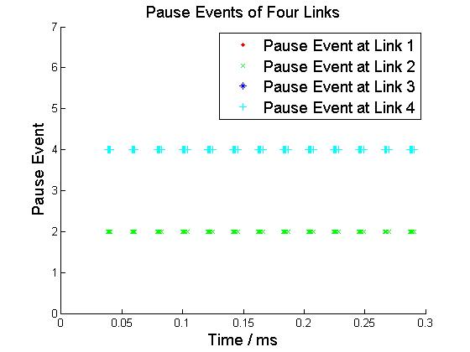

Non-Loop Deadlock –
Cyclic Routing Dependency $≠$ Deadlock
r₁ = B
S1
S2
Flow 1
tx
rx
rx
L1
tx
L4
L2
r₂ = B
tx-1
L3
rx
S4
S3
Flow 2
tx-2
rx
tx
In this case, cyclic routing dependency is met but no deadlock.
Cyclic routing dependency is just a necessary condition as it is not guaranteed that all the links will be paused.

Slide 20
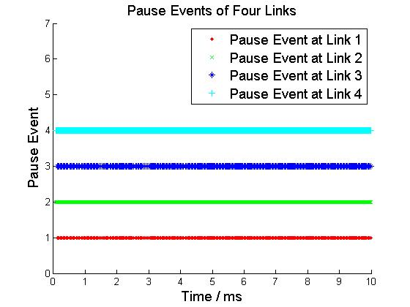

Non-Loop Deadlock –
Simultaneous Pause $≠$ Deadlock
Flow 3
TX-2
rate limit=1/4
r₁ = B
S1
S2
Flow 1
TX
RX 2
TX-1
RX 1
r₂ = B
TX-1
RX 3
S4
RX 4
S3
Flow 2
TX
rate limit=1/4
TX-2
Flow 4
In this case, all the links in the cycle are paused at the same time but no deadlock.
Simultaneous Pause is just a necessary condition as it is not guaranteed that all the pauses will not be resumed.

Slide 21
Non-Loop Deadlock – Deadlock Prediction
Deadlock Prediction is not a trivial thing.
Two algorithms for deadlock prediction:
Non-lineal Fluid Model with Differential Equations (currently don’t know how to solve the equations)
Iterative Algorithm based on Statistical Model (currently don’t know how to prove the correctness)
Using simulations to demonstrate that both algorithms can correctly predict whether deadlock will happen for the 6 deadlock scenarios.

Slide 22
Solution for Preventing Deadlock in Clos Network
Core 1
Core 2
Priority = 2
Priority = 1
Aggr 1
Aggr 2
Aggr 3
Aggr 4
Priority = 1
Priority = 2
ToR 1
ToR 2
ToR 3
ToR 4
H1: 10.0.0.1
H2: 10.1.1.1
Key Idea: we increase the packet priority of a flow each time the flow changes its direction from DOWN to UP. We drop the packet when no higher priority is available.

Slide 23
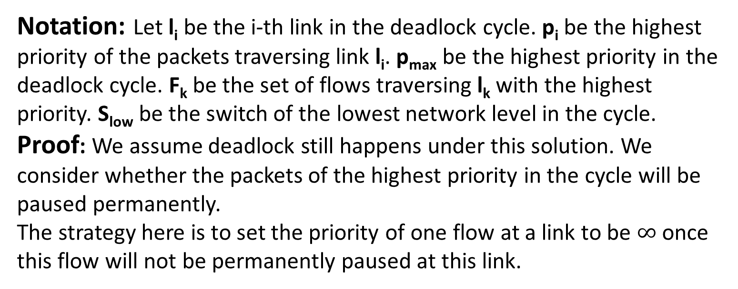
Solution for Preventing Deadlock in Clos Network
Highest Priority of l₁ = p₁
l₁
l₂
Highest Priority of l₂ = p₂
Highest Priority of l_{n} = p_{n}
l_{n}
l₃
Highest Priority of l₃ = p₃
…
Notation: Let l_{i} be the i-th link in the deadlock cycle. p_{i} be the highest priority of the packets traversing link l_{i}. p_{max} be the highest priority in the deadlock cycle. F_{k} be the set of flows traversing l_{k} with the highest priority. S_{low} be the switch of the lowest network level in the cycle.
Proof: We assume deadlock still happens under this solution. We consider whether the packets of the highest priority in the cycle will be paused permanently.
The strategy here is to set the priority of one flow at a link to be $∞$ once this flow will not be permanently paused at this link.

Slide 24
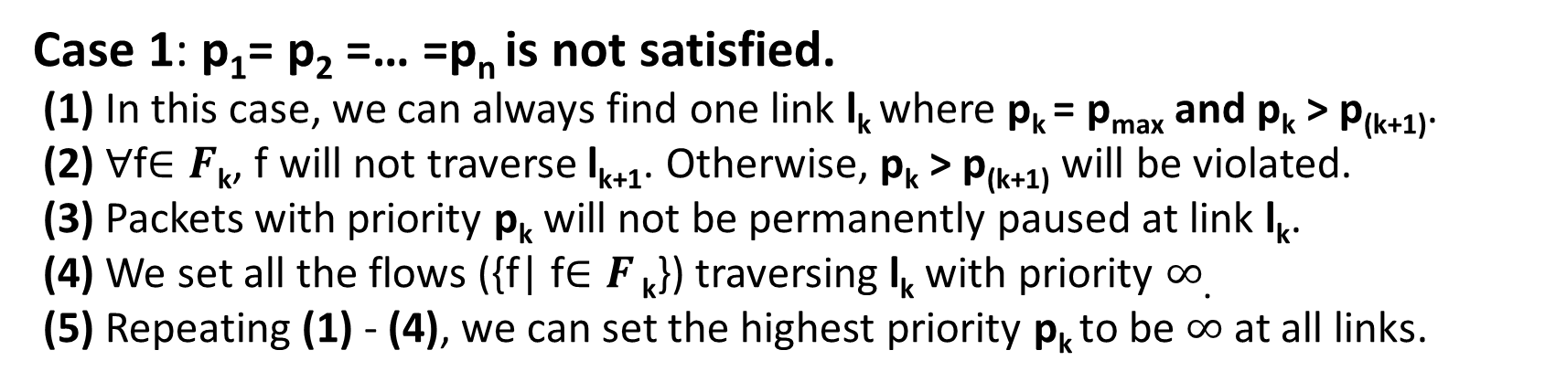
Solution for Preventing Deadlock in Clos Network
Notation | Description
l_{i} | the i-th link in the deadlock cycle
p_{max} | the highest priority in the deadlock cycle
p_{i} | the highest priority of the packets traversing link l_{i}
F_{k} | the set of flows traversing l_{k} with the highest priority p_{i}
l₁
l₂
…
l_{k+1}
…
l_{k}
p_{k} > p_{(k+1)}
Case 1: p₁= p₂ =… =p_{n} is not satisfied.
(1) In this case, we can always find one link l_{k} where p_{k} = p_{max} and p_{k} > p_{(k+1)}.
(2) ∀f$∈F\text{k}$, f will not traverse l_{k+1}. Otherwise, p_{k} > p_{(k+1)} will be violated.
(3) Packets with priority p_{k} will not be permanently paused at link l_{k}.
(4) We set all the flows ({f| f$∈F$ $\text{k}$}) traversing l_{k} with priority $∞$.
(5) Repeating (1) - (4), we can set the highest priority p_{k} to be $∞$at all links.

Slide 25
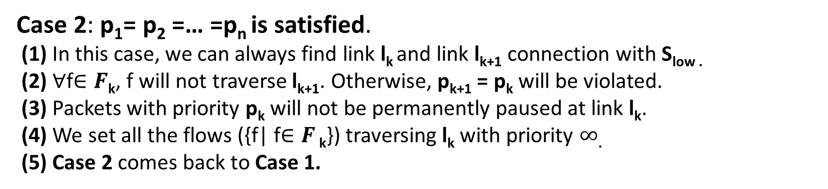
Solution for Preventing Deadlock in Clos Network
Notation | Description
l_{i} | the i-th link in the deadlock cycle
S_{low} | the switch of the lowest network level in the cycle.
p_{i} | the highest priority of the packets traversing link l_{i}
F_{k} | the set of flows traversing l_{k} with the highest priority p_{i}
l₁
l₂
…
l_{k+1}
…
l_{k}
S_{low}
f_{k}
Case 2: p₁= p₂ =… =p_{n} is satisfied.
(1) In this case, we can always find link l_{k} and link l_{k+1} connection with S_{low .}
(2) ∀f$∈F\text{k}$, f will not traverse l_{k+1}. Otherwise, p_{k+1} = p_{k} will be violated.
(3) Packets with priority p_{k} will not be permanently paused at link l_{k}.
(4) We set all the flows ({f| f$∈F$ $\text{k}$}) traversing l_{k} with priority $∞$.
(5) Case 2 comes back to Case 1.

Slide 26
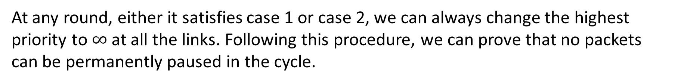
Solution for Preventing Deadlock in Clos Network
l₁
l₂
…
l_{k+1}
…
l_{k}
At any round, either it satisfies case 1 or case 2, we can always change the highest priority to $∞$at all the links. Following this procedure, we can prove that no packets can be permanently paused in the cycle.

